Slide 1

Enthuse: Foundation of Data Science in Python
Instructors:
Thangavel Prasanth
Ho Mun Kit
Li Pengfei

Slide 2
Program Schedule
Time | Program
09:00 – 09:30 | Introduction: What is Data Science
09:30 – 11:00 | Introduction to Python
11:00 – 12:30 | Python libraries for Data Science
12:30 – 13:30 | Lunch
13:30 – 16:30 | Hands-on Mini Projects
16:30 – 17:00 | Q&A

Slide 3
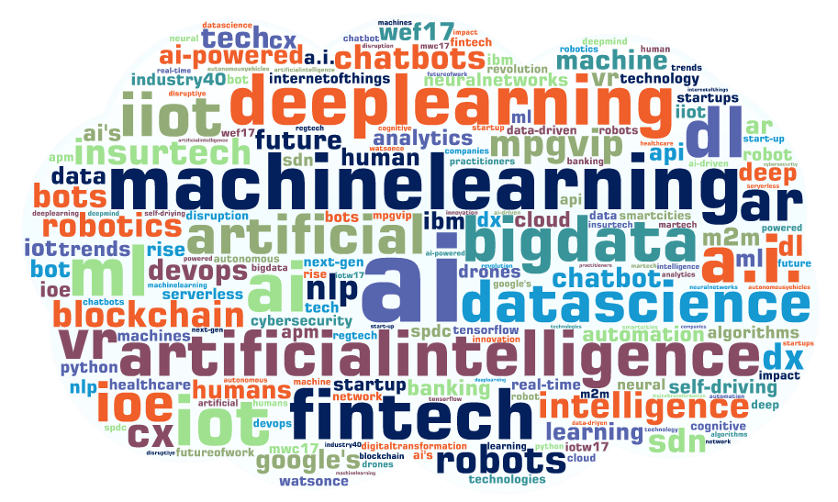
What is data science?
Notes:
can fill up with more information about Iot, machine learning and other stuff

Slide 4

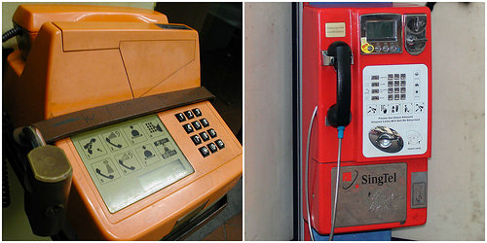

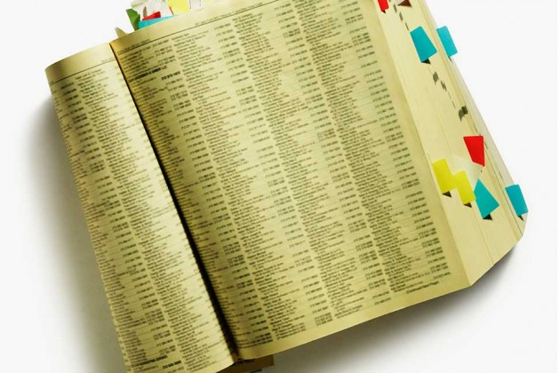
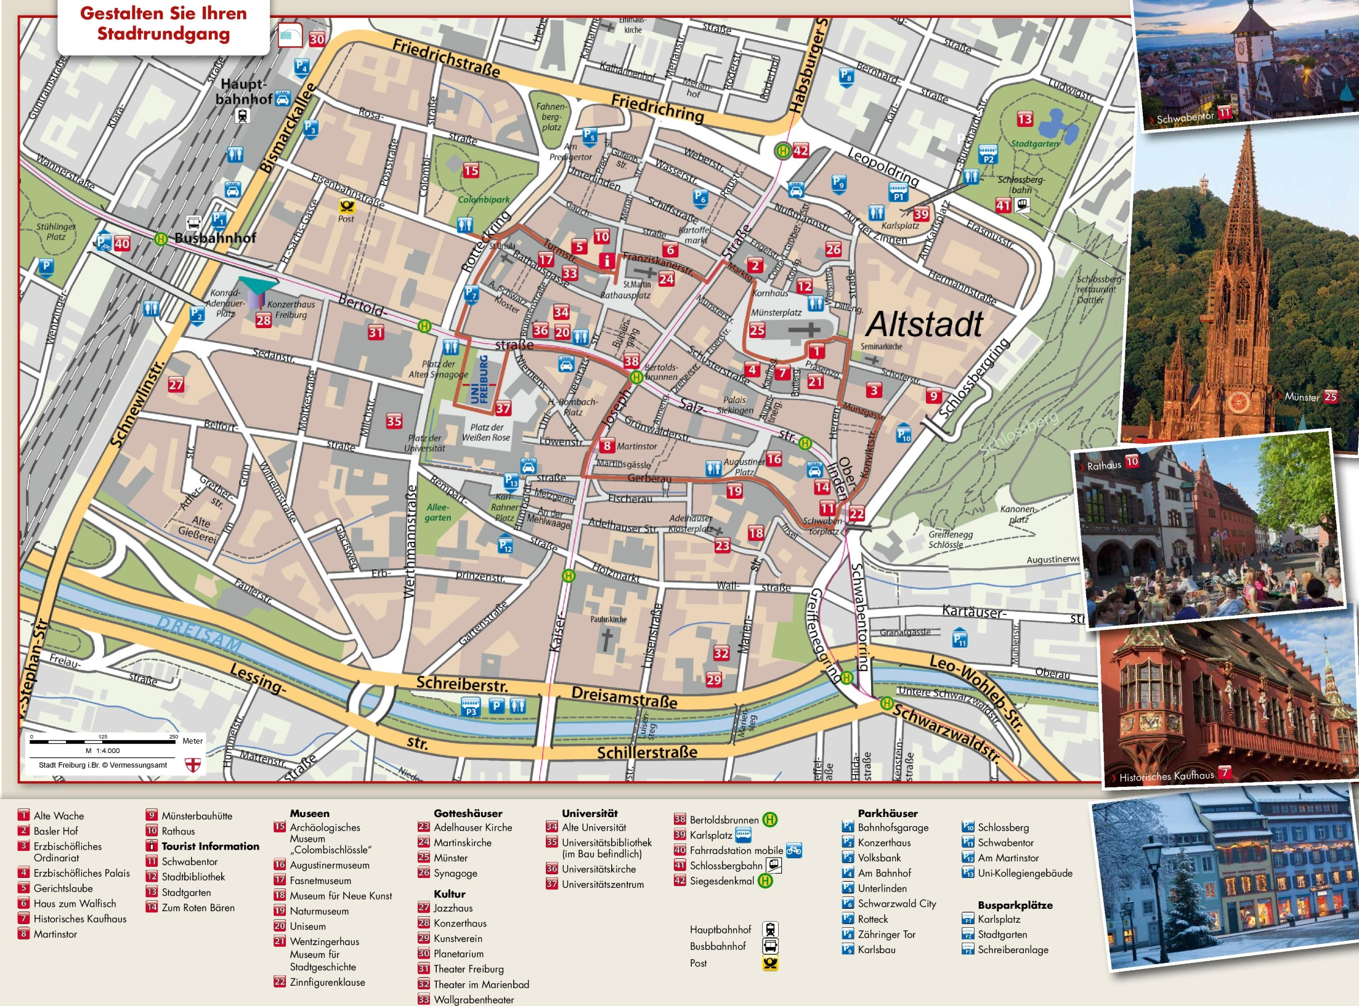
Data and information from places you hardly notice
Notes:
Data and information are available at places you don’t usually look out for

Slide 5
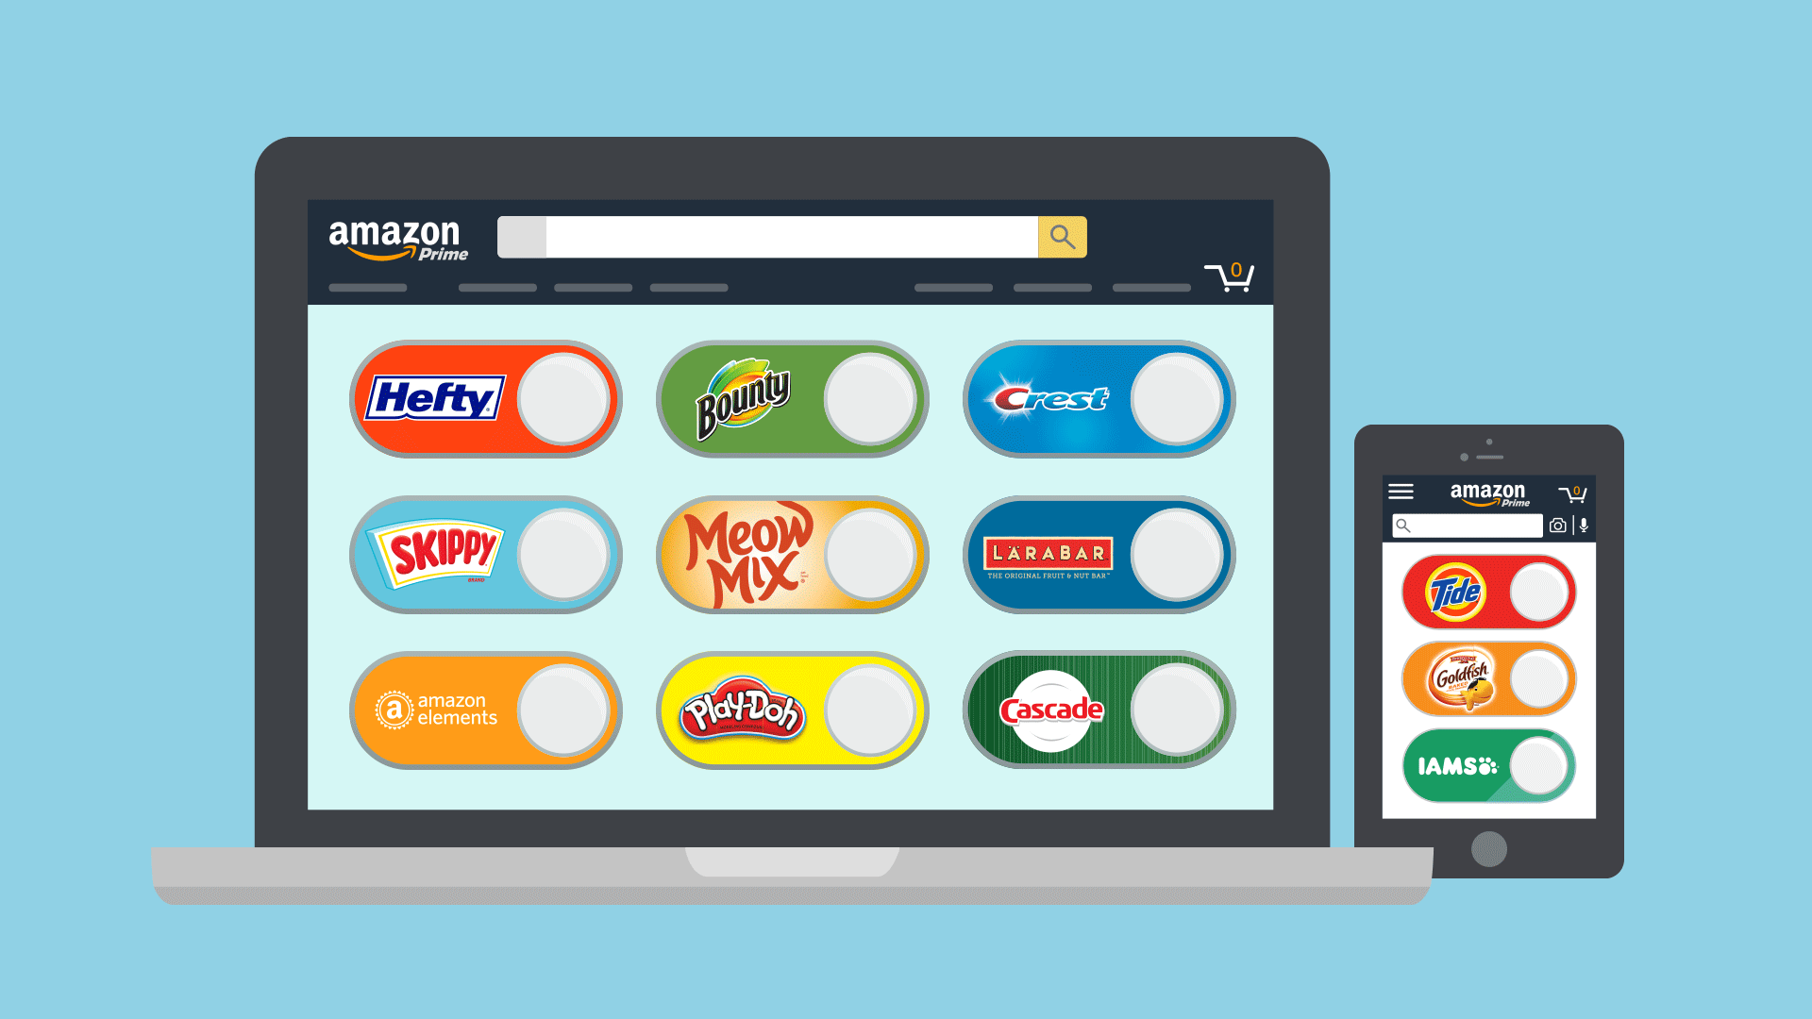
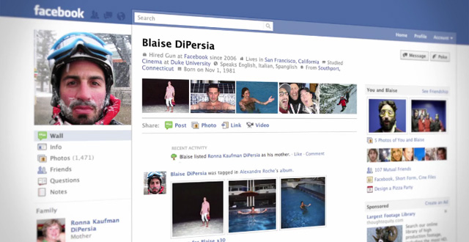
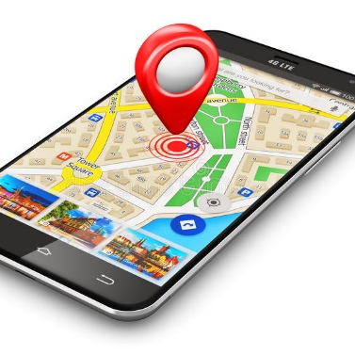
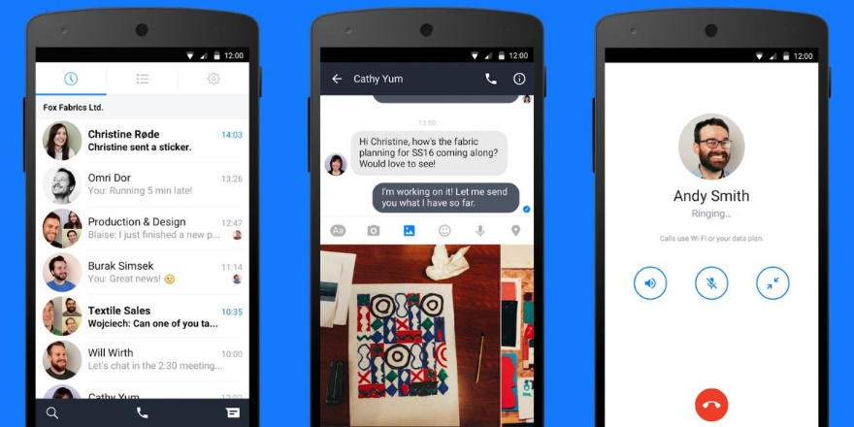
We are consuming and generating data every day

Slide 6
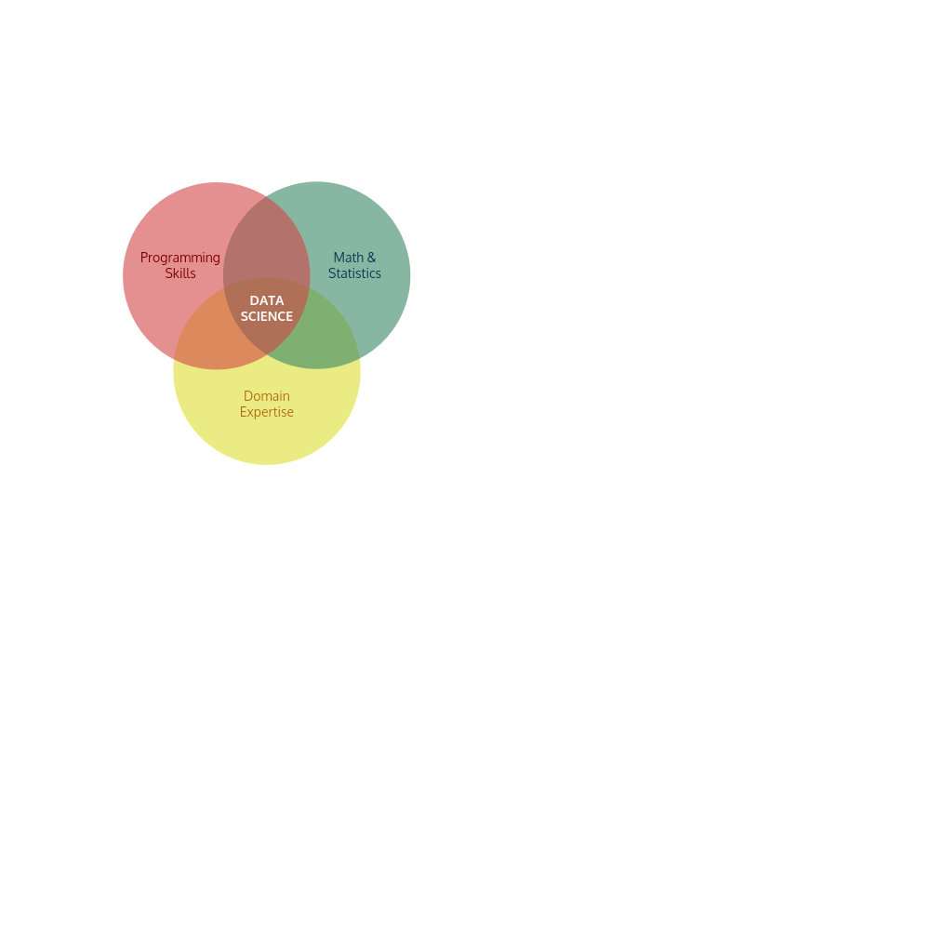


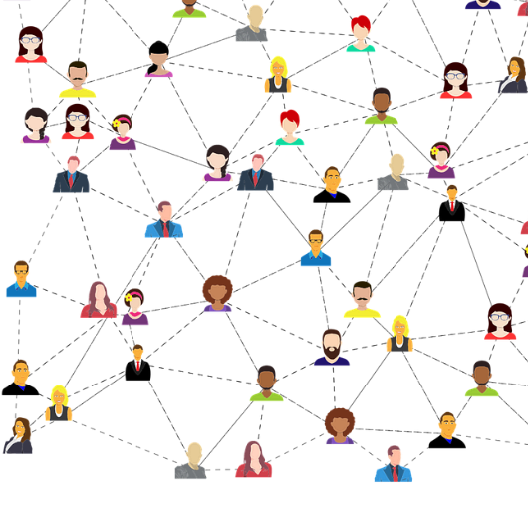

Data science
Exploration and analysis of data in order to discover meaningful patterns to answer critical questions
?
?
Advertising
Social
Networks
Notes:
Remove intersection nouns
change

Slide 7
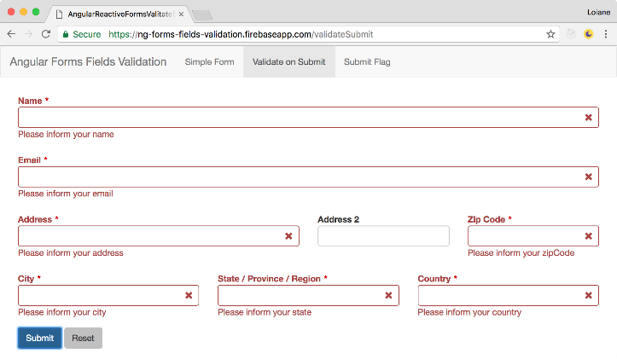
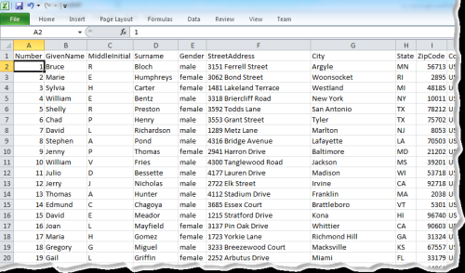
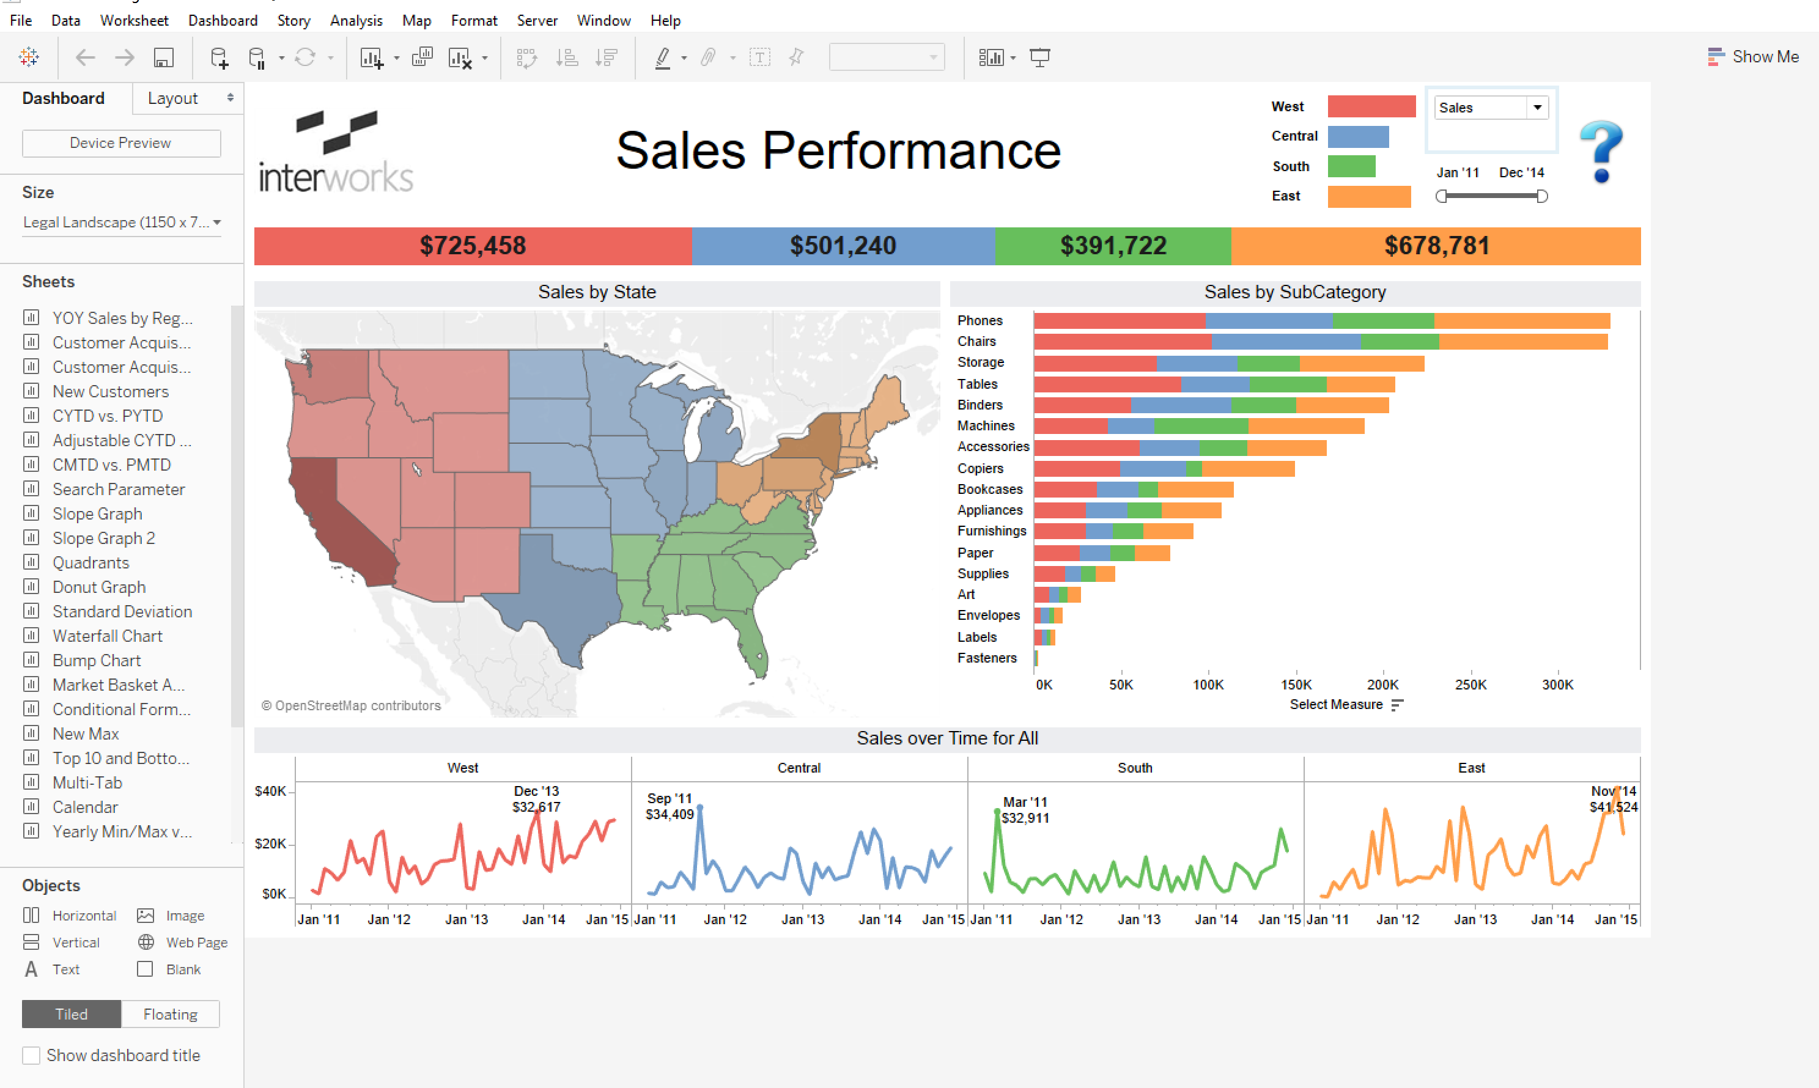
Data
Information
Knowledge
OBJECTIVE: Extract knowledge to automate decision-making of identical problems in the future

Slide 8
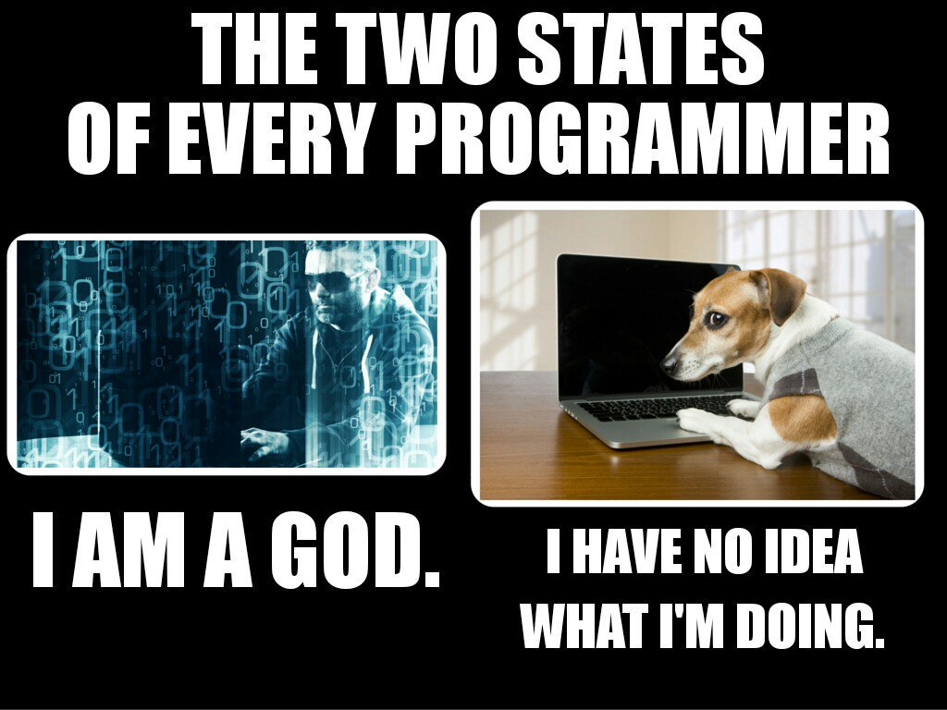
programming
How do I tell a computer to accomplish a certain task?

Slide 9
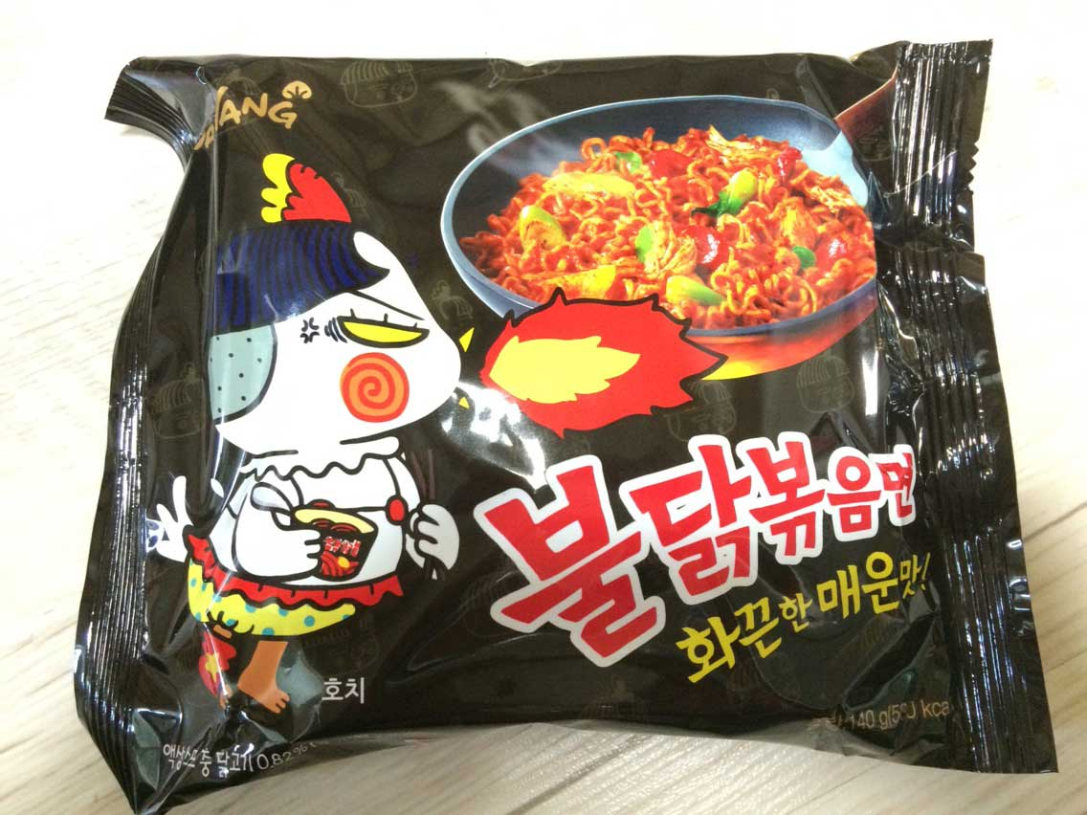
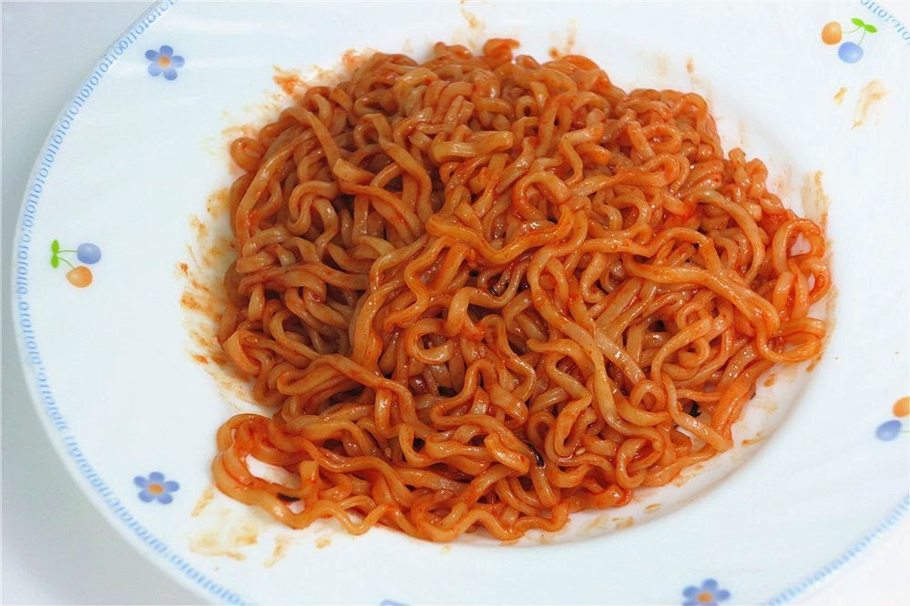
Exercise: How do I cook this pack of noodles?
Tips:
What do you need?
Which indicators do you look out for?
Noodles in packaging
?
...
?
Ready to eat

Slide 10
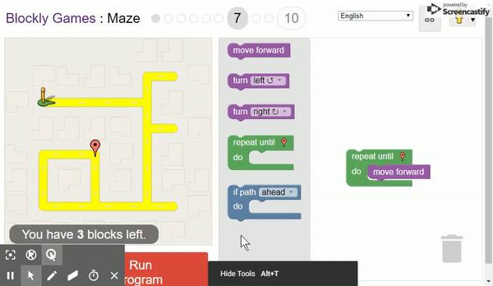
Quick hands-on: Robot Guidance
Link: https://bit.ly/1zIvq2z

Slide 11
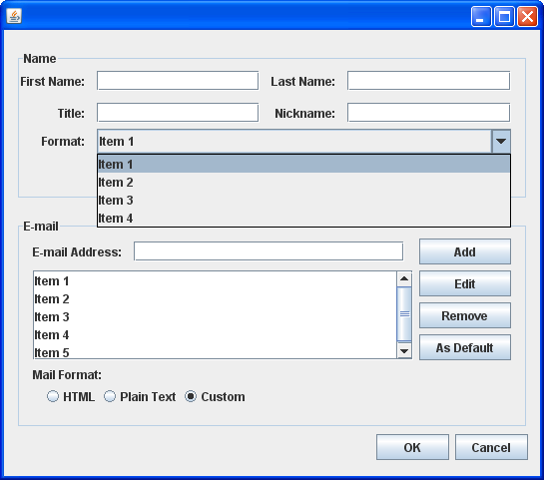
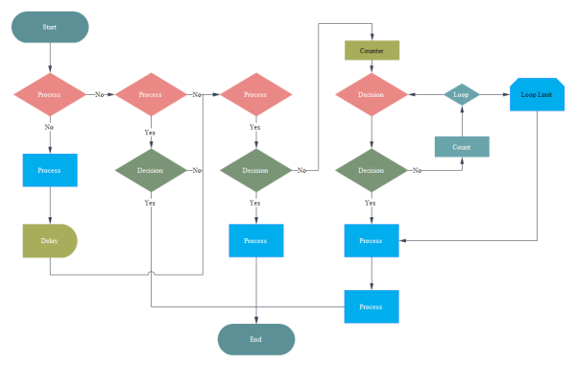
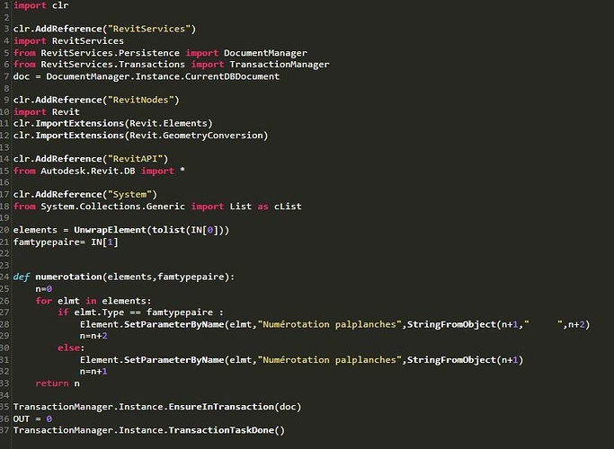
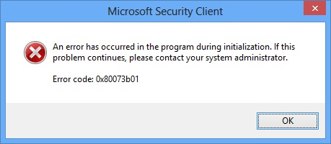
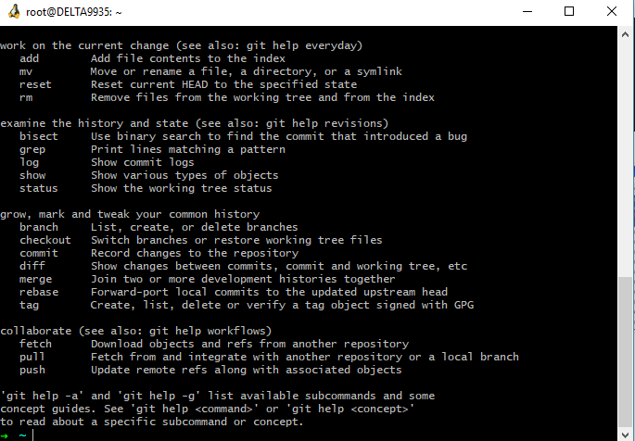
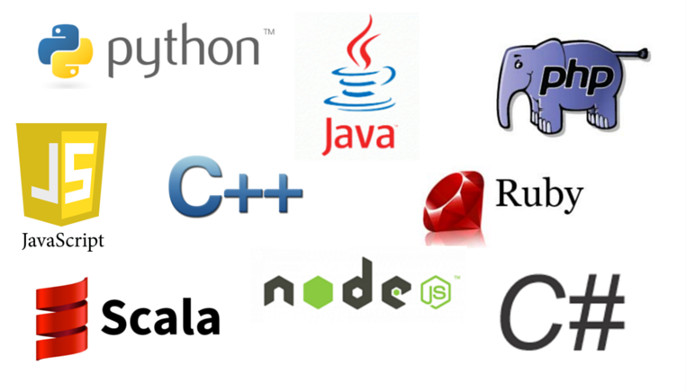
Classic software
Decompose the problem
Design algorithms
Measure performance
Integrate into a system
Notes:
each line of code, the programmer identifies a specific point in program space with some desirable behavior.
Cooking example recipe. Cooking instant noodle... prepare toast....
https://blockly-games.appspot.com/?lang=en

Slide 12
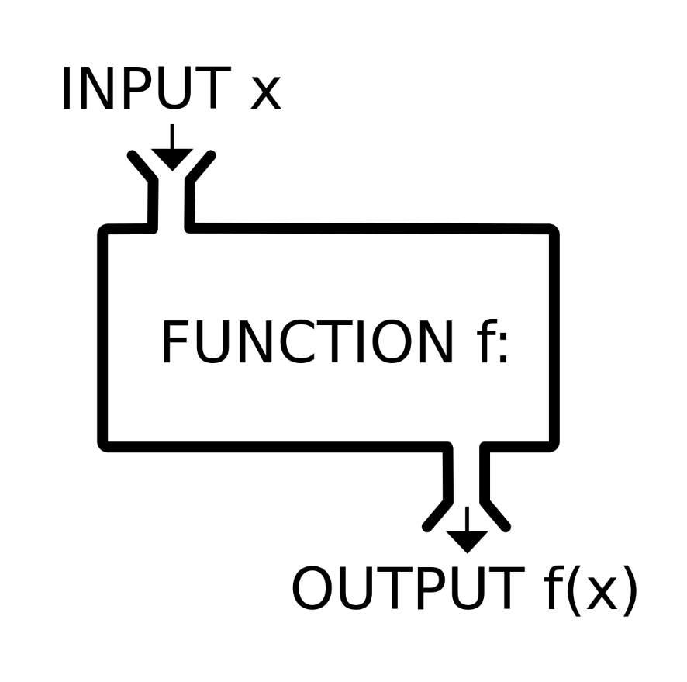


SOFTWARE 2.0
Machine learning algorithms

Slide 13
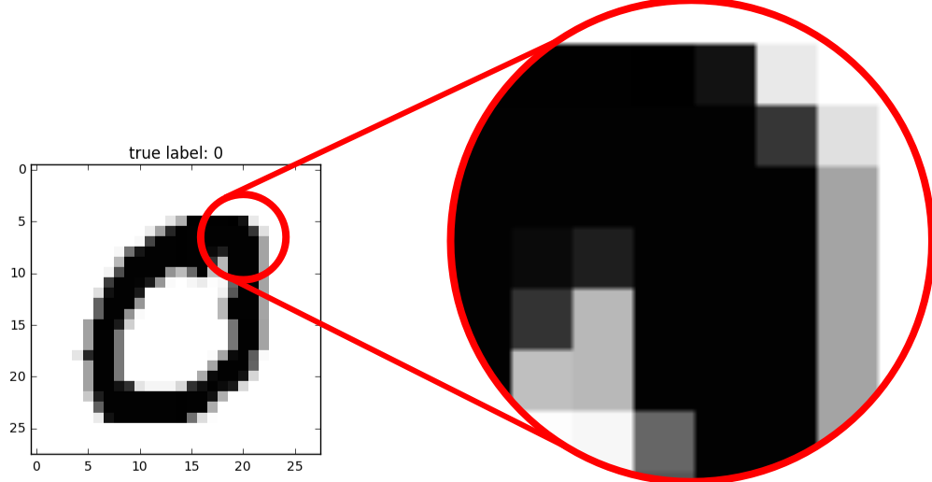
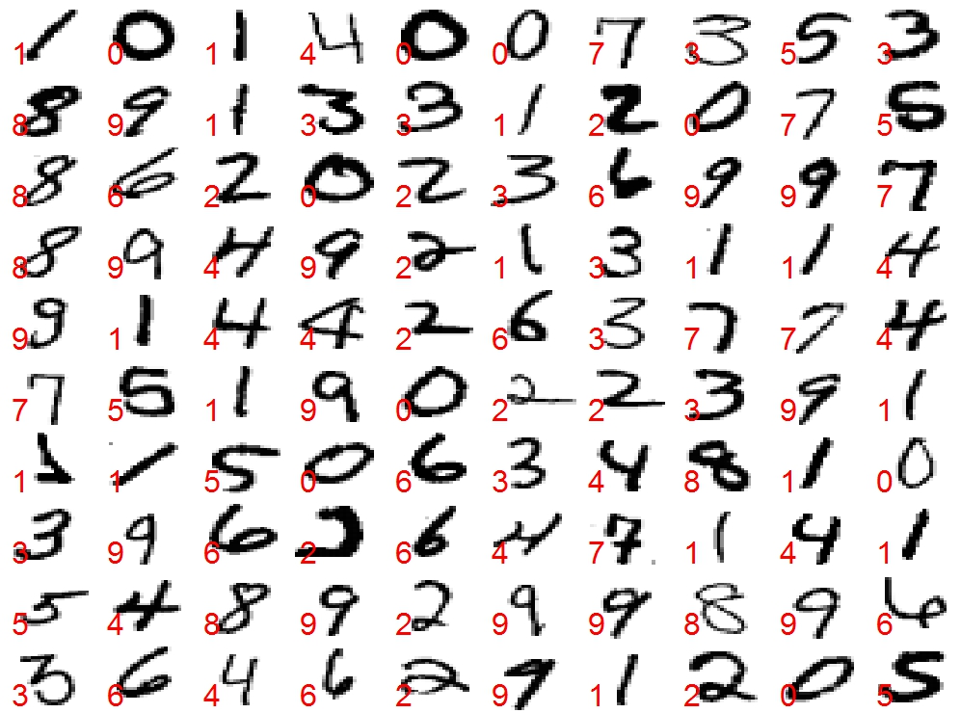
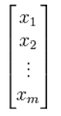
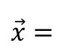
Programming a more complex task
Handwriting recognition
task
Classifier algorithm
0
Each 8-bit pixel takes the value of 0-255
$$\vec{x}=$$

Slide 14
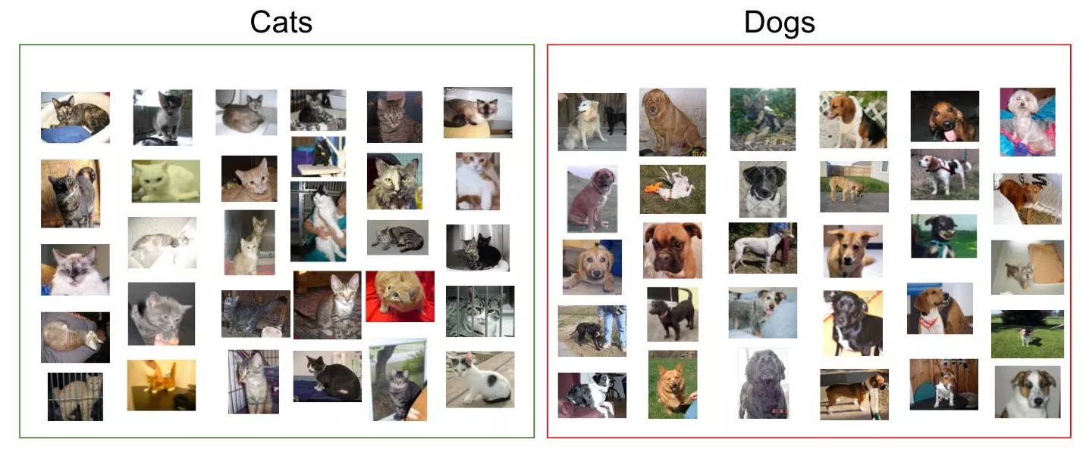

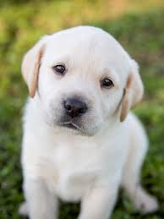
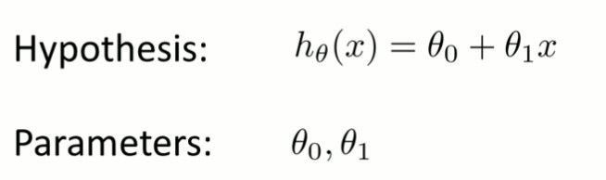

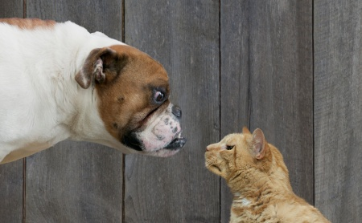
Machine Learning Algorithms
CAT
CAT
Prepare data
Select hypothesis function
Computer searches for a program/function
Measure performance
?
Specify desirable goal
Notes:
our approach is to specify some goal on the behavior of a desirable program (e.g., “satisfy a dataset of input output pairs of examples”, or “win a game of Go”), write a rough skeleton of the code (e.g. a neural net architecture), that identifies a subset of program space to search, and use the computational resources at our disposal to search this space for a program that works

Slide 15
ML/AI applications in real world

Slide 16
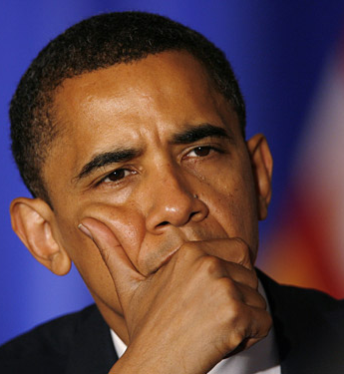
ML/AI applications in real world
So, how do you actually use ML/AI?
Where do you collect the data from? How do you use it to solve problems of the real world?
Notes:
Now, we talk about how ML/AI fuses with EEE.

Slide 17
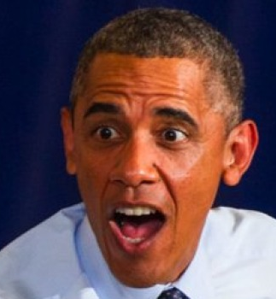
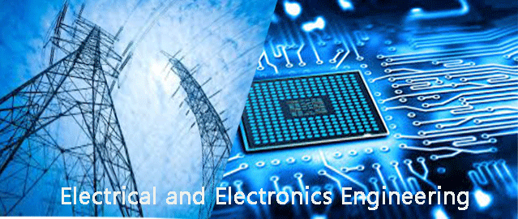
ML/AI applications in real world
So, how do you actually use ML/AI?
Where do you collect the data from? How do you use it to solve problems of the real world?
Signals Sensors Data ML
Notes:
Now, we talk about how ML/AI fuses with EEE.

Slide 18

ML and Signal Processing?
IEEE Signal Processing Society
https://www.youtube.com/watch?v=mexN6d8QF9o

Slide 19
ML and Robotics?
Shkurti, Florian, et al. "Underwater multi-robot convoying using visual tracking by detection." Intelligent Robots and Systems (IROS), 2017
IEEE/RSJ International Conference on. IEEE, 2017.
https://www.youtube.com/watch?v=Em7V-vBApHc

Slide 20
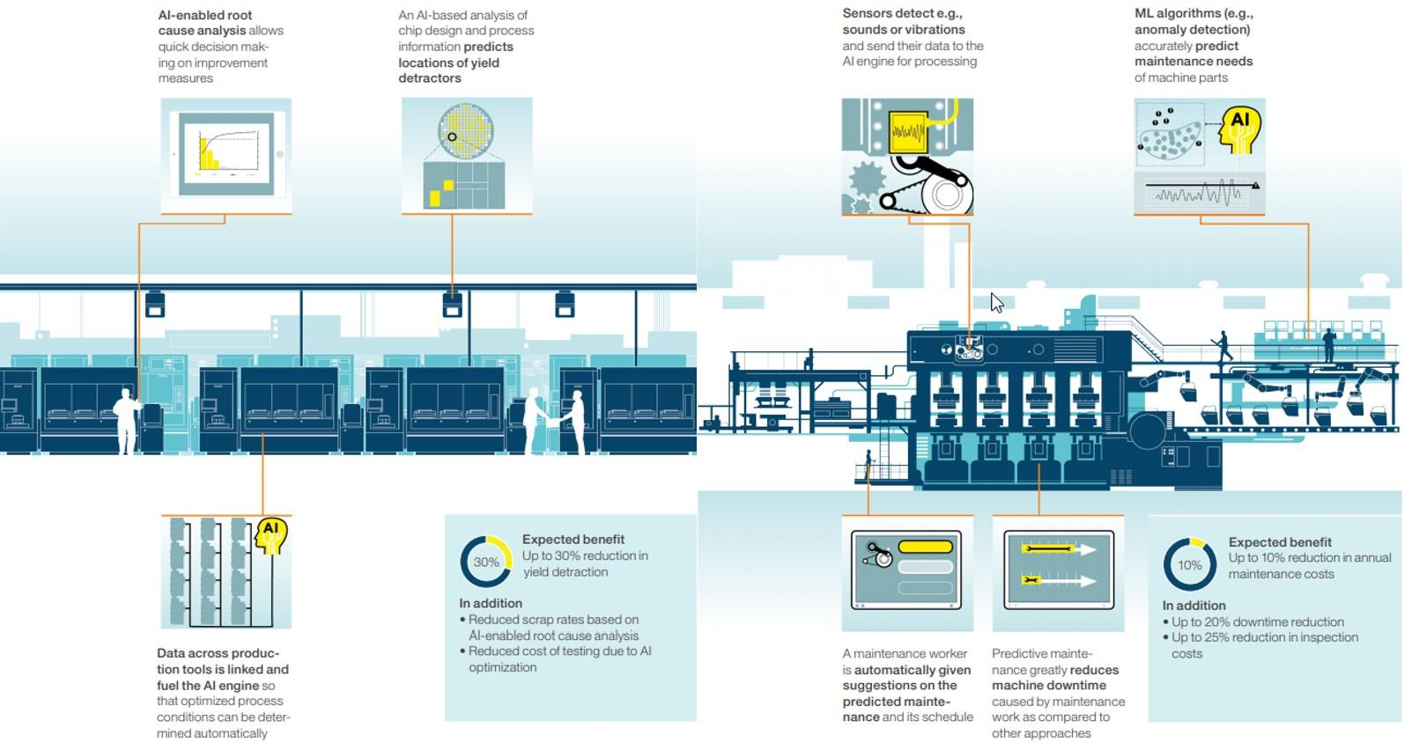
ML and Manufacturing (IoT)?
AI/ML everywhere??

Slide 21
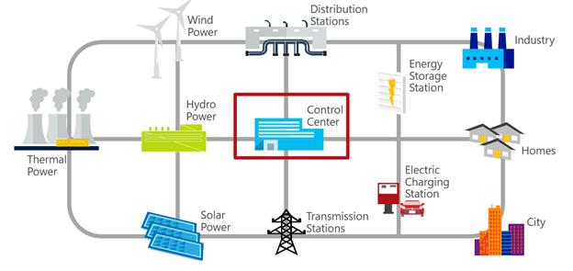

ML and Power Systems?
Load/Demand Forecasting
Fault Detection and Classification
Weather/ Wind Forecasting

